Slide 1
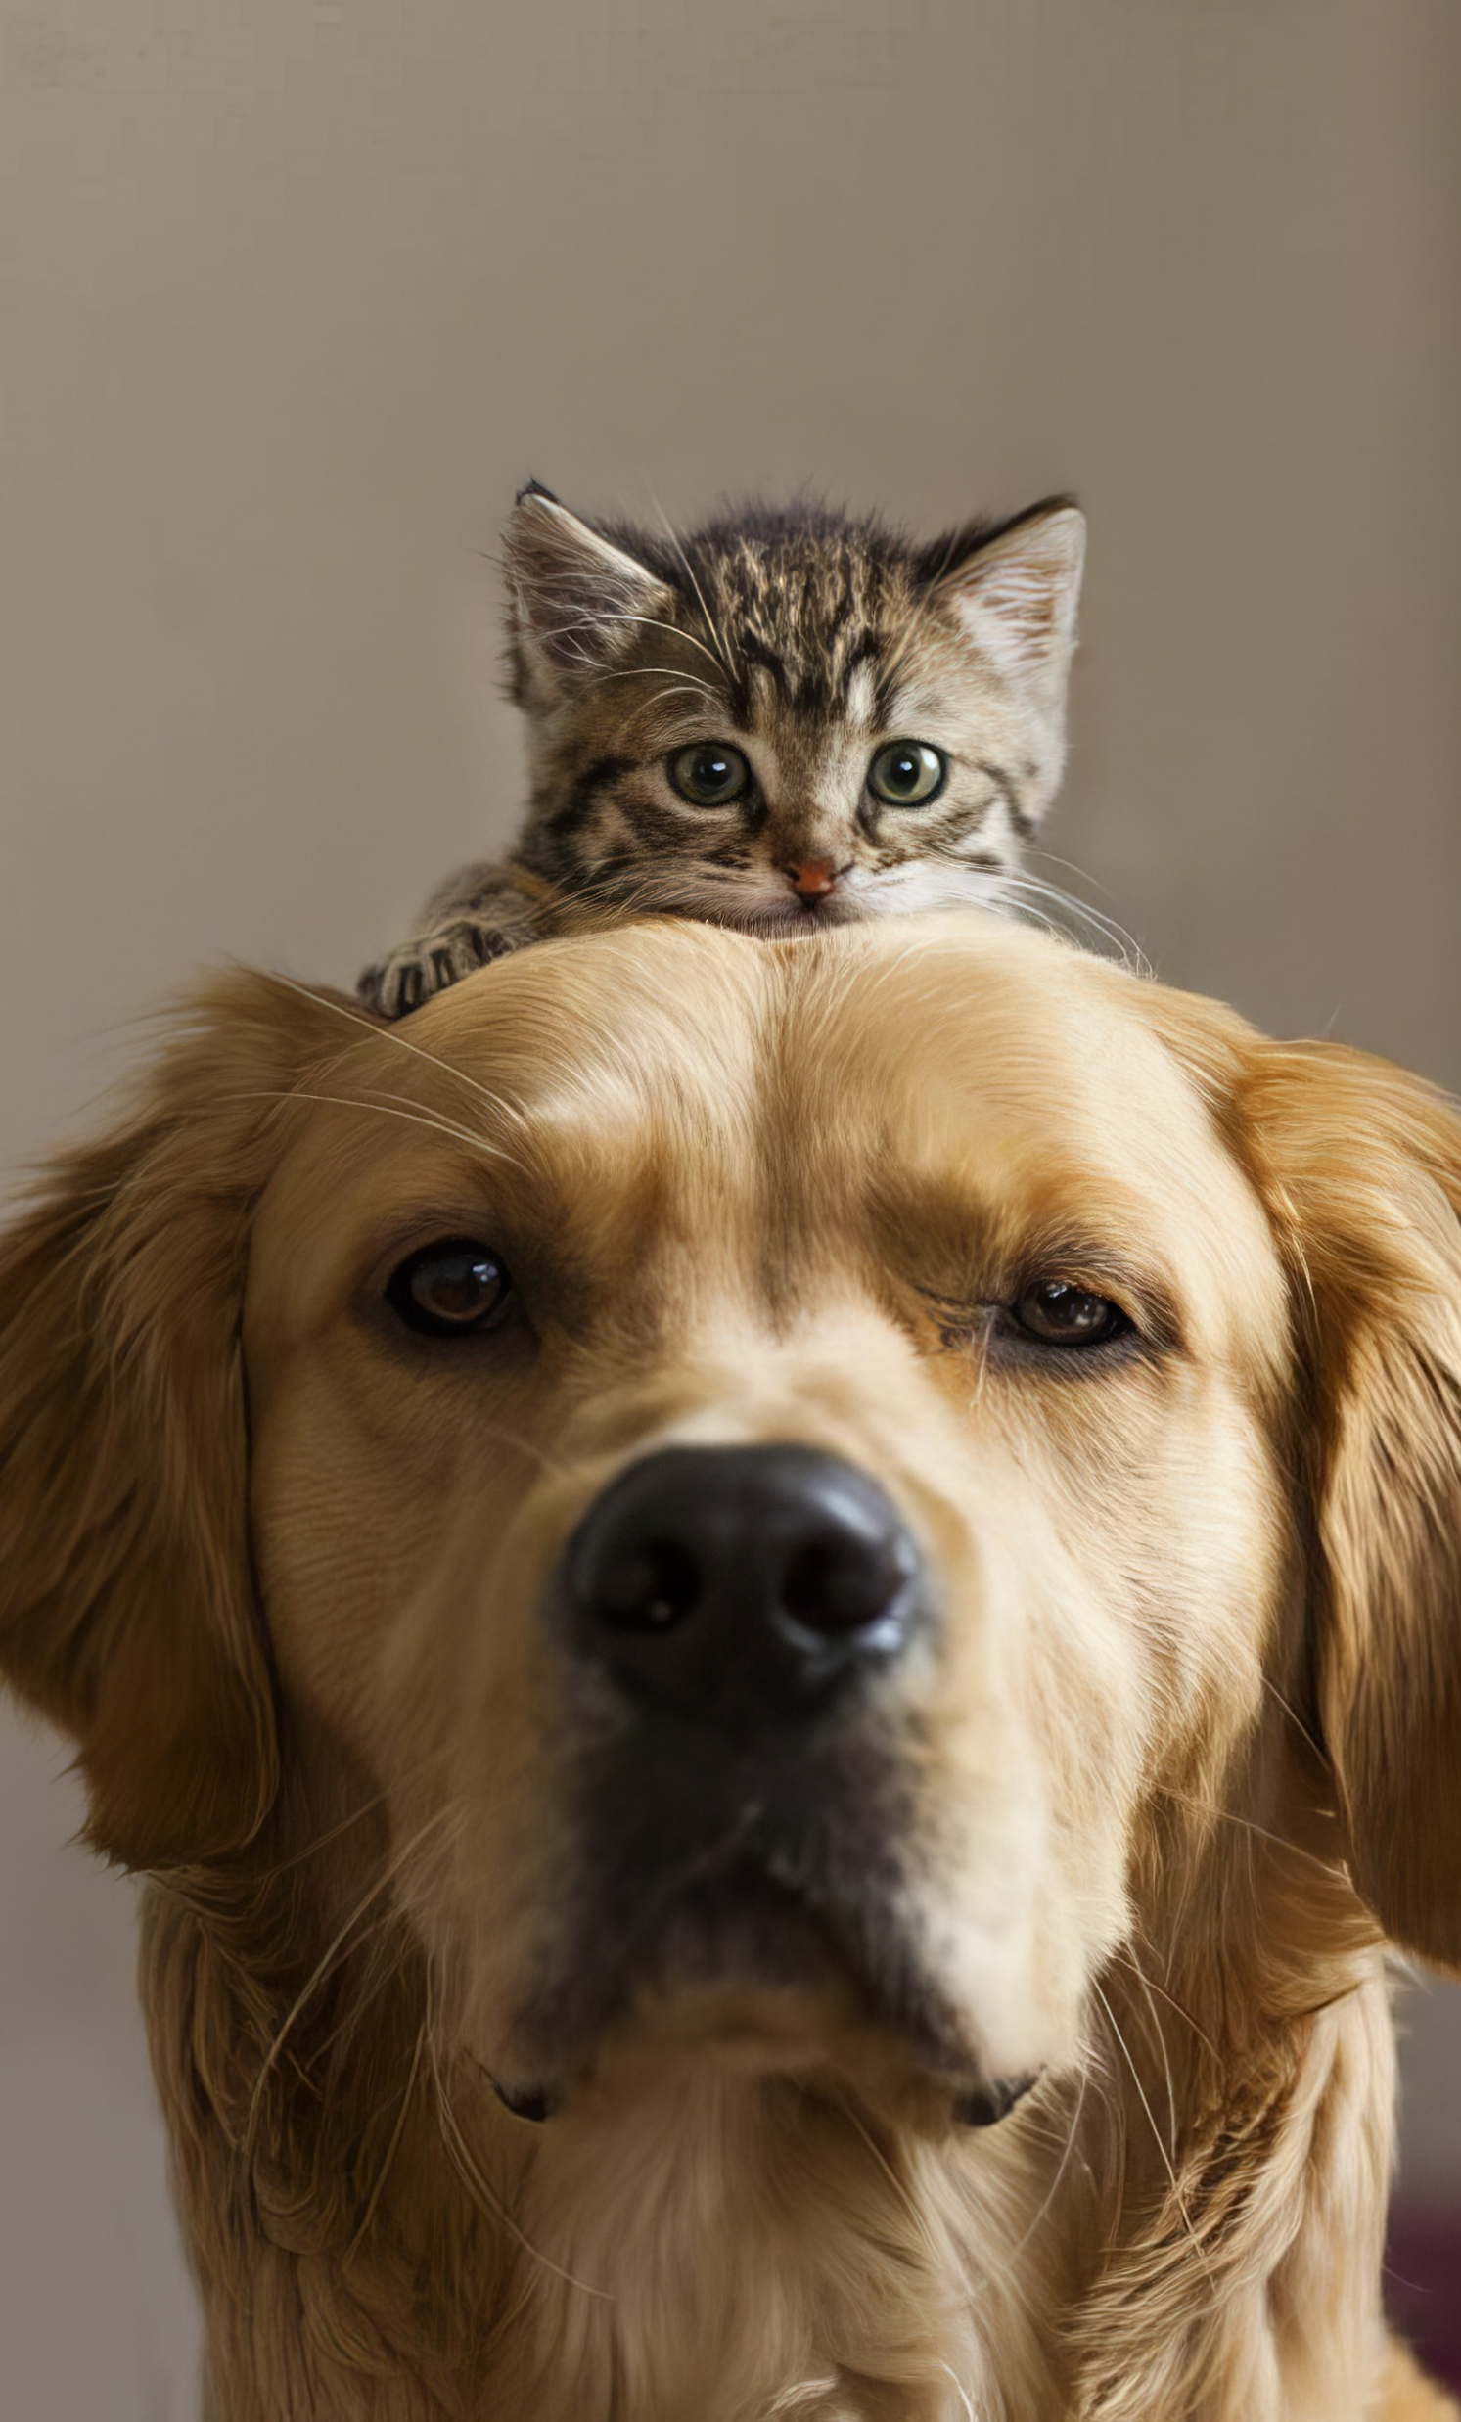

Pettofy
TAILORED PET CARE DELIVERED YOUR WAY
Highlights your delivery service with a friendly, approachable feel.
Presented by Uddipto Barua (CSE 02807575) Forhaduzzaman Remon (CSE 02807594) Sacin Arman (CSE 02807584)
Assigned by Safayet Nur Lecturer Dept. of CSE Port City International University

Slide 2










CONTENTS
Pettofy
01
INTRODUCTION
INTRODUCTION
limitation
OR Problem STATEMENT
MOTIVATION
The primary goal of this project is to create an accessible website where users can easily find pets available for adoption and purchase, order essential pet products, and access expert guidance on pet care. Our mission is to make pet ownership simple, meaningful, and informed—ensuring that pets find loving homes and owners feel fully supported every step of the way.
Objective
FEATURES
METHODOLOGY
Benefits of
Our system
Pettofy
CONCLUSIONS
REFERENCES

Slide 3
LIMITATION
OR PROBLEM STATEMENT
01
INTRODUCTION
The primary goal of this project is to create an accessible website where users can easily find pets available for adoption and purchase, order essential pet products, and access expert guidance on pet documentation. Our mission is to make pet ownership simple, meaningful, and informed—ensuring that pets find loving homes and owners feel fully supported every step of the way.
Pettofy

Slide 4

01
INTRODUCTION
Pettofy
The primary goal of this project is to create an accessible website where users can easily find pets available for adoption and purchase, order essential pet products, and access expert guidance on pet documentation. Our mission is to make pet ownership simple, meaningful, and informed—ensuring that pets find loving homes and owners feel fully supported every step of the way.
Pettofy

Slide 5
LIMITATION
OR PROBLEM STATEMENT
Pettofy
Pettofy
#pet care that’s Finally easy and all in one place

Slide 6

LIMITATION
OR PROBLEM STATEMENT
Pettofy
03
MOTIVATION
Saturated Platforms
Finding everything in one location is challenging for pet owners.
Limited Delivery Options
Delivery pets in Bangladesh is not enough popular due to lack of professionalism.
As passionate pet lovers, we understand how challenging it can be to find trustworthy information, quality pets, and essential products at one place in Bangladesh. This project inspires us to create a service that not only simplifies pet adoption and purchase but also supports pet owners in providing care for their beloved companions.
Lack of Online Support
Most existing pet services do not provide comprehensive online guidance
Absence of Transparency
Often, buyers lack access to complete health, vaccination, and microchipping records for pets.
Pettofy

Slide 7
LIMITATION
OF PRESENT SYSTEM
03
MOTIVATION
As passionate pet lovers, we understand how challenging it can be to find trustworthy information, quality pets, and essential products at one place in Bangladesh. This project inspires us to create a service that not only simplifies pet adoption and purchase but also supports pet owners in providing care for their beloved companions.
Pettofy

Slide 8

Pettofy
Centralized Pet Services
To create a single platform that offers pet import, adoption, veterinary care, pet supplies, and delivery services.
FEATURES
PROJECT
OBJECTIVES
Pet Delivery Solutions
To establish a reliable, safe, and pet-friendly delivery service across various cities in Bangladesh.
The objective of this project is to create an all-in-one platform for having pet, pet adoption, products, and services, making pet care convenient.
Enhance Pet Ownership Experience
To make pet care easier, more informed, and accessible by providing resources, expert advice, and quality products.
Promote Ethical Practices
To emphasize responsible sourcing, proper documentation, and animal welfare for all pets available on the platform.

Slide 9




Pettofy
METHODOLOGY
SYSTEM ARCHITECTURE
Pettofy
Pet Adoption and Listings
A section dedicated to available pets for adoption, purchase with detailed profiles, including health records and vaccinations.
FEATURES
PROJECT
OBJECTIVES
Home Delivery
Safe, specialized delivery options for both pets and pet supplies
The platform offers pet adoption, a store for essentials, and professional services like veterinary care and pet boarding, with safe delivery and educational resources.
The objective of this project is to create an all-in-one platform for pet adoption, products, and services, making pet care convenient.
Professional Services
Bookable services for veterinary care, pet sitting/walking, and boarding.
Pet Essentials Store
A shop offering pet food, toys, medicines, and accessories.

Slide 10
Pettofy
METHODOLOGY
SYSTEM ARCHITECTURE
Name
E-mail
Phone No
Password
User Interaction
Customer Terms
Service
Log In/ Register
Pet Adoption
Pet Info
Contact Provider
Contact Info
Policy Agreement
Pet Details
Pet Category
User Module
Form Link
Update Service
Location (From & To)
Pet Hub
Pet Condition
Pet Support
Pet Import & Documentation
Delete Service
Our Services
Pet Foods
Adoption Policies
Pet Owner Details
Pet Adoption
Pet Hub
Appoint a Vet for Service
Info
Pet Delivery
Pet Health & Care
Pet & Owner Info
Service Category
Pet Veterinarian
Check Info
Pet Support
About Pettofy
Pet Sitter
Mobile No
Pet Passport
Pet Items
Applicable enquiry
Owner Info
Pet Hostel
Vet On Call
Gallery
Pet Info
Pet Relocation
Status
About Us
Pet Sitter/Walker
Pet Vaccination Info
Our Partners
Available
Hourly rate
Airport & Flight Info
Pet Relocation Info
Admin Module
Contacts
Not Available
Owner location
Owner Info
Manage Service
Order
Manage Info
Owner Current Status
Accept
Manage Status
Reject
Location Details
Manage Order

Slide 11
Pettofy
METHODOLOGY
SYSTEM ARCHITECTURE
User Module
Admin Module
Our Services
Manage Service
Manage Info
Pet Hub
System Module
Manage Status
Pet Support
Manage Order
System Information Gather
Vet On Call
About Us
Permission Request
Reject
Service Booked
Accept
Payment Method
Service Processing

Slide 12


Benefits.
of our System..
Convenience
Reliability and Safety
Transparency
Community Building
Our system makes it easy to find pets, buy supplies, and get expert help all in one place. It also builds trust by providing complete health records and reliable delivery options, so owners can feel confident and supported.
Provides all essential pet services under one platform, saving time for pet owners and enthusiasts. Our system provides a convenient platform to find pets, buy supplies, and access expert services all in one place.
Ensures safe delivery and veterinary care, backed by certified professionals. It ensures reliability and safety by offering trustworthy delivery and quality control.
Detailed health and certification information for all pets, building trust with customers. With complete health records and transparent processes, users can make informed choices confidently..
Encourages responsible pet ownership and strengthens the pet care community. Plus, Pettofy fosters a community of pet lovers, making pet ownership more enjoyable and supportive.
Pettofy

Slide 13



Conclusion.
of our systematic project proposal…..
Benefits.
of our System..
Convenience
Reliability and Safety
Transparency
Community Building
Our system makes it easy to find pets, buy supplies, and get expert help all in one place. It also builds trust by providing complete health records and reliable delivery options, so owners can feel confident and supported.
Provides all essential pet services under one platform, saving time for pet owners and enthusiasts. Our system provides a convenient platform to find pets, buy supplies, and access expert services all in one place.
Ensures safe delivery and veterinary care, backed by certified professionals. It ensures reliability and safety by offering trustworthy delivery and quality control.
Detailed health and certification information for all pets, building trust with customers. With complete health records and transparent processes, users can make informed choices confidently..
Encourages responsible pet ownership and strengthens the pet care community. Plus, Pettofy fosters a community of pet lovers, making pet ownership more enjoyable and supportive.
Pettofy

Slide 14




Conclusion.
of our systematic project proposal…..
Pet Care Solution
Our platform aims to revolutionize pet care in Bangladesh by bringing everything needed for pet ownership into a single, reliable system.
Commitment to Quality
We are committed to prioritizing pet welfare and customer satisfaction, making it easier for people to welcome and care for pets responsibly.
Vision for Growth
With a growing number of pet owners in Bangladesh, our service has the potential to expand and support the entire pet care ecosystem.
Pettofy
Pettofy

Slide 15







System Requirements.
of our systematic project proposal…..
Frontend Development
Backend Development
NodeJs
Payment Integration
Pettofy

Slide 16
References
Furryghor https://furryghor.com
Paw Foundation https://pawfoundationbd.org
Volza https://www.volza.com

Slide 17

Thank You Everyone.
Think Pet . Think Pettofy

